Slide 1

Expanding Reporting Capabilities with Jupyter Notebook, Pandas, and Seaborn
Anthony Melson & Jonas Malave Campos

Slide 2
Agenda
Why does this approach matter?
What are Jupyter Notebook, Pandas, and Seaborn?
Connection to data sources, central features, and extensions
Completing necessary Set Up
Demo/Walkthrough with Pandas and Seaborn
More from Jupyter Environment

Slide 3
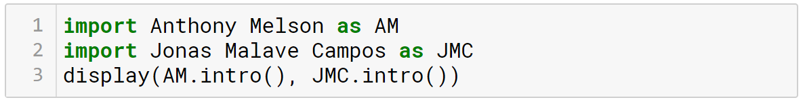
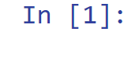


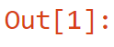
Introduction Anthony & Jonas
Anthony Melson
Jonas Malave Campos
Data Scientist
Senior Specialist in Advanced Analytics at Caleres
Data Analyst/Business Analyst
Consultant at Sense Corp

Slide 4




What’s the problem?
We need to report on our new digital marketing, but we don’t know our KPIS yet.
Requires preprocessing beyond SQL capabilities.
Let’s start iterating on this new report and see where it takes us.
Requires machine learning.

Slide 5




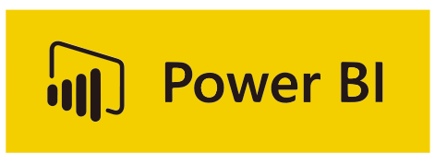

Solution
What are my options?

Slide 6




Why Does This Matter?
Iterative Reporting
Faster Than BI Tools
Flexibility and Power for All Tasks
Leveraging
Notebook Environment Capabilities

Slide 7

Let’s Understand Jupyter Notebook and Its Features

Slide 8




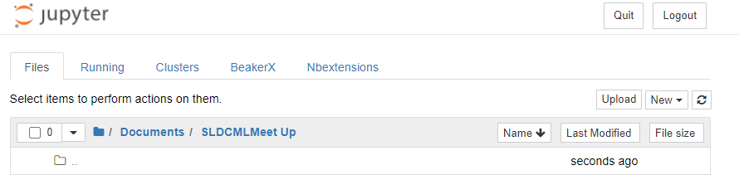
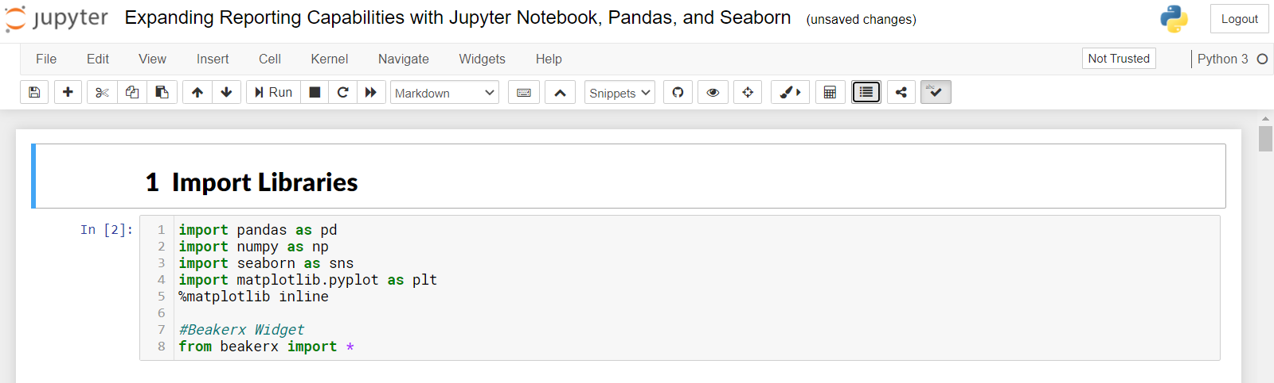
Jupyter Notebook
Open Source
Programming Languages
Notebook
Data Science & More

Slide 9


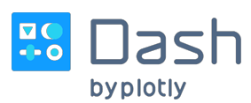

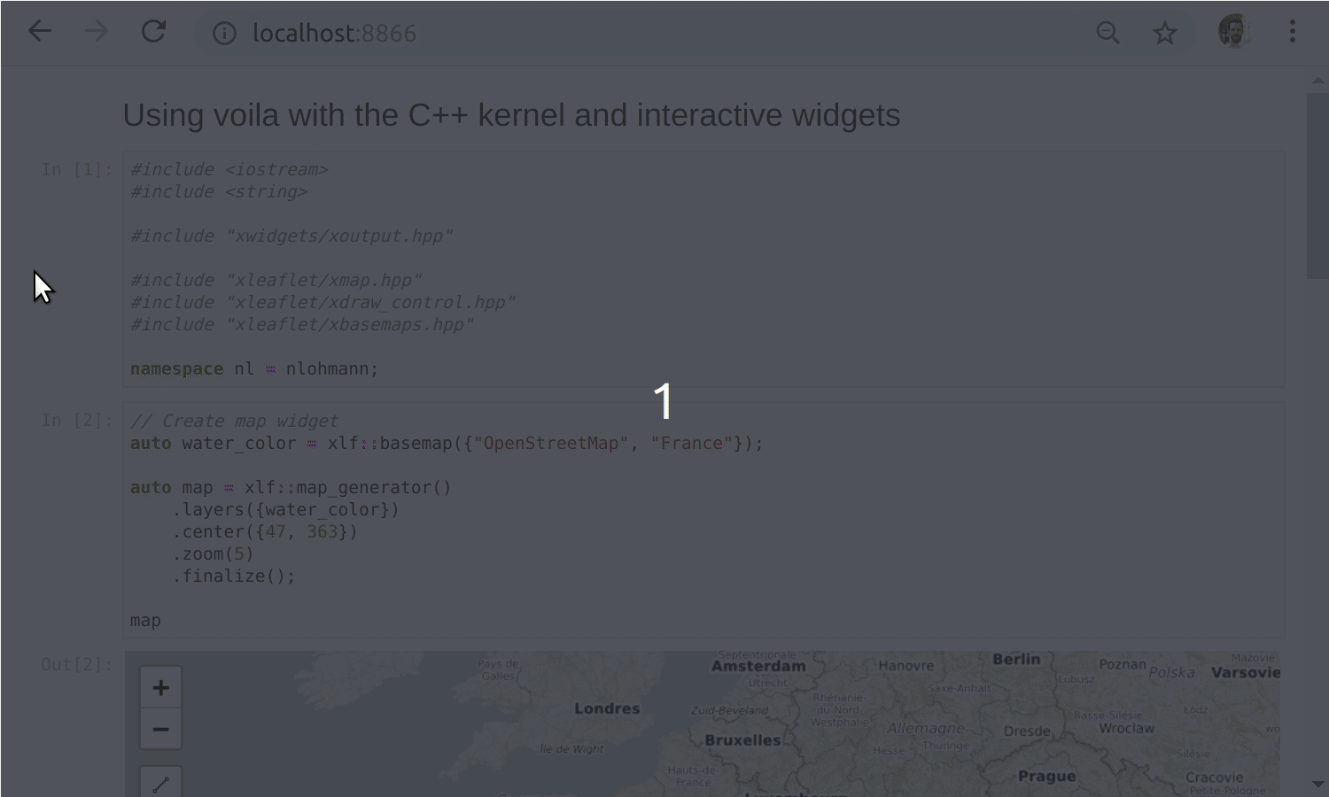
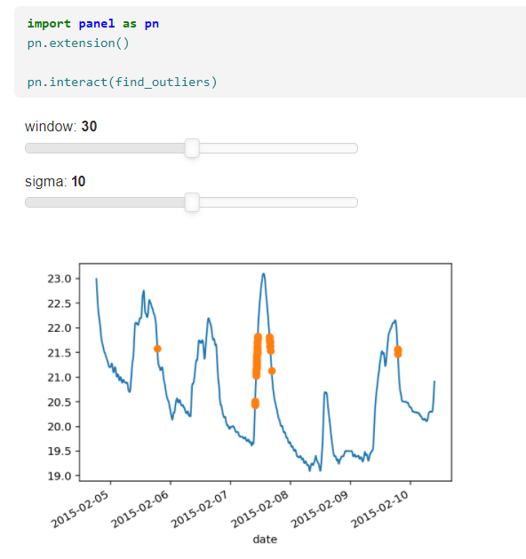
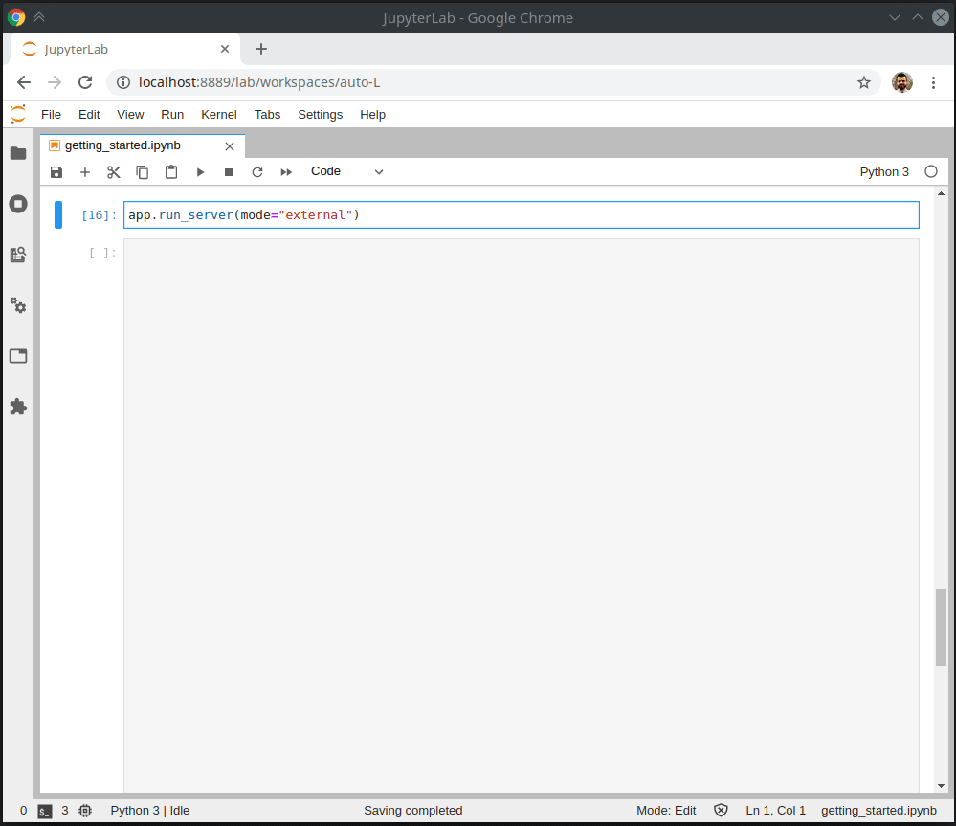
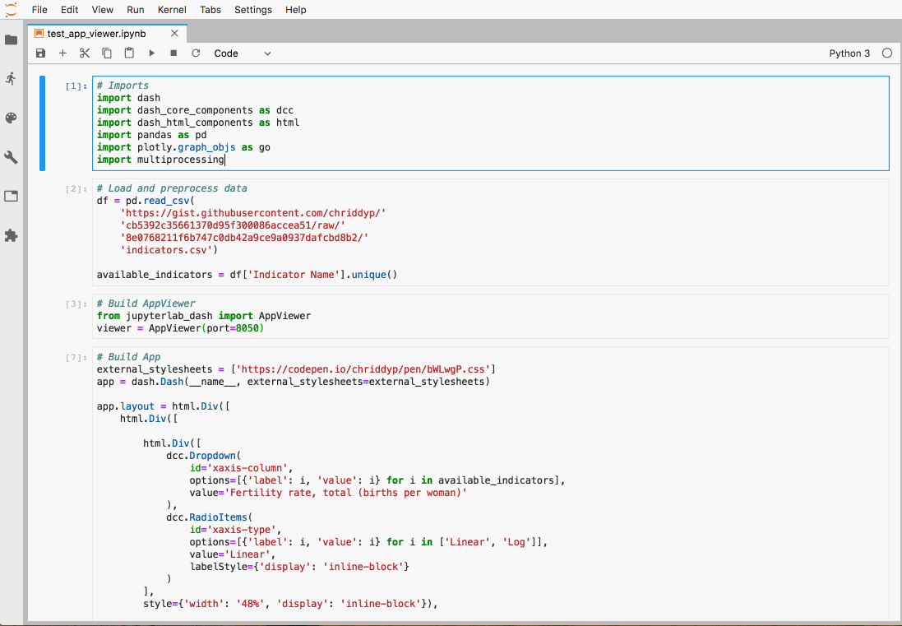
Other Popular Delivery Methods
Voila
Panel
Dash
Streamlit

Slide 10




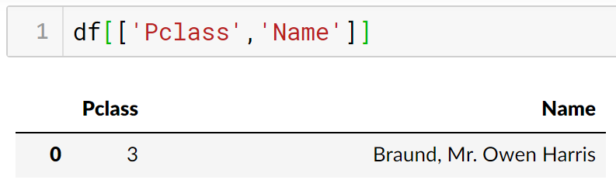
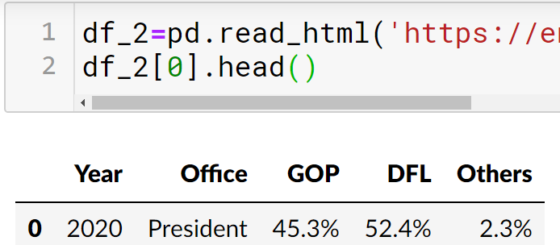
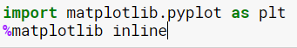
Pandas Library
Data Manipulation
Powerful and Flexibility
Integrated Plotting

Slide 11
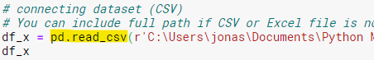
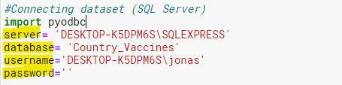
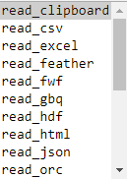
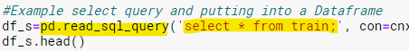
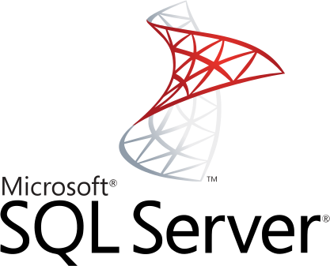



Connecting to Sources
Pandas
PyODBC

Slide 12
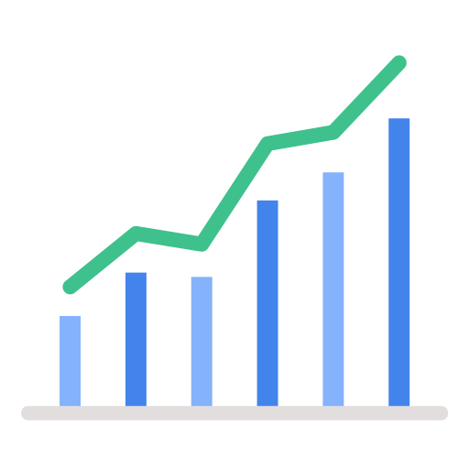




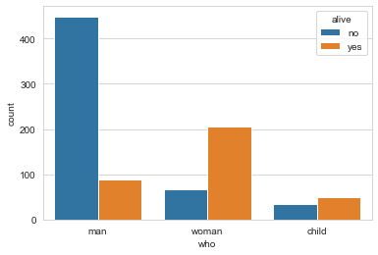
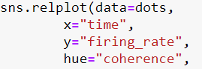
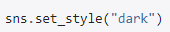
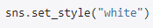
Seaborn Library
Statistical Graphics
Plotting Functions
Customization
Integration

Slide 13
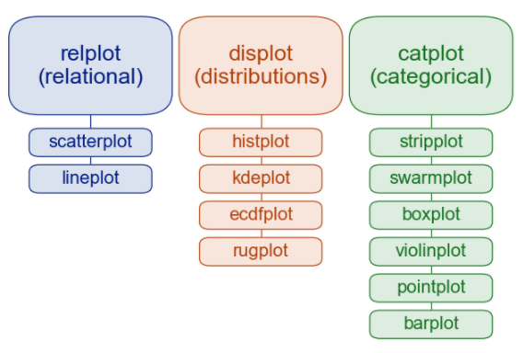
Some Seaborn Plotting Options

Slide 14
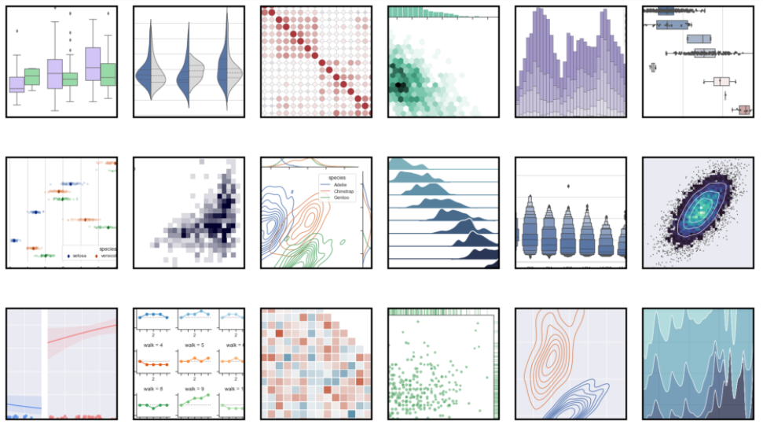
Seaborn Sample Gallery

Slide 15

Setting Up The Environment

Slide 16
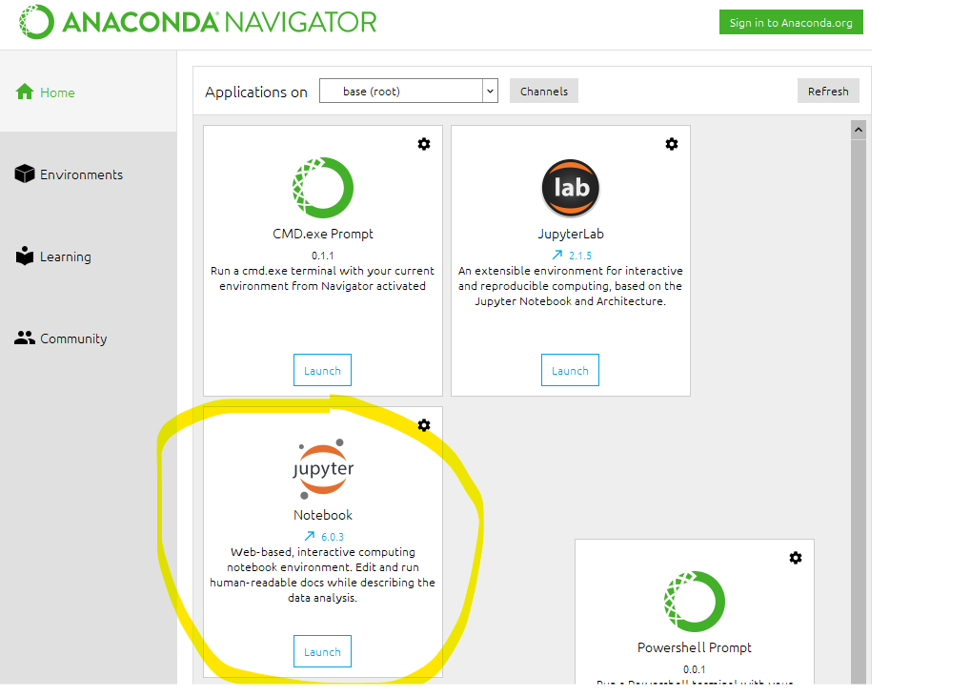
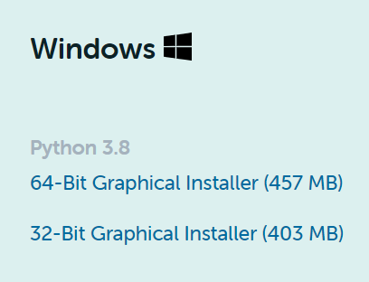
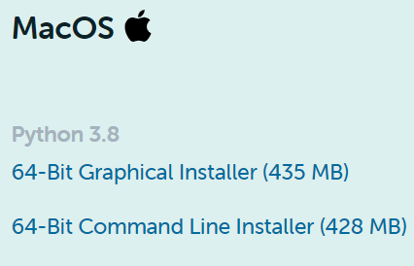
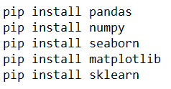
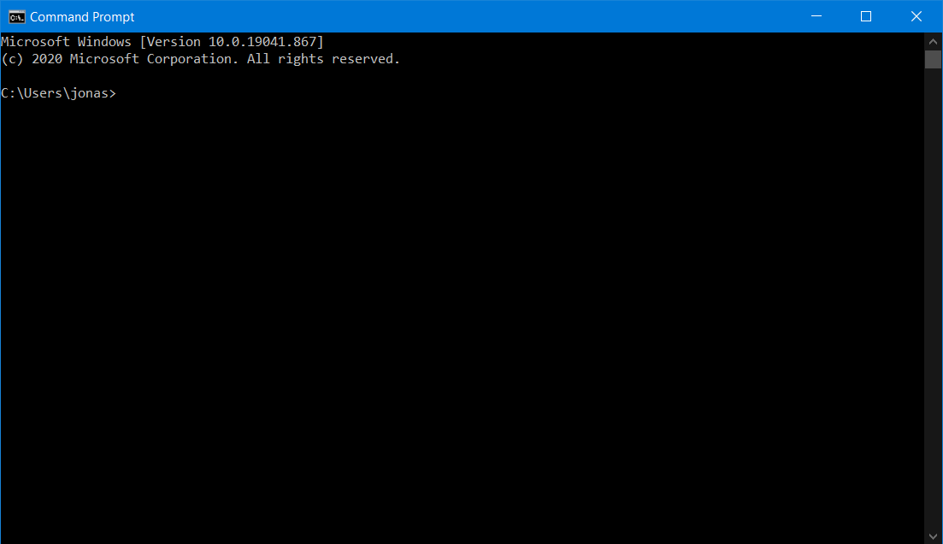


How to Install The Basic Environment
Install Anaconda IDE
Install Libraries
Open Anaconda & Use Jupyter Notebook

Slide 17
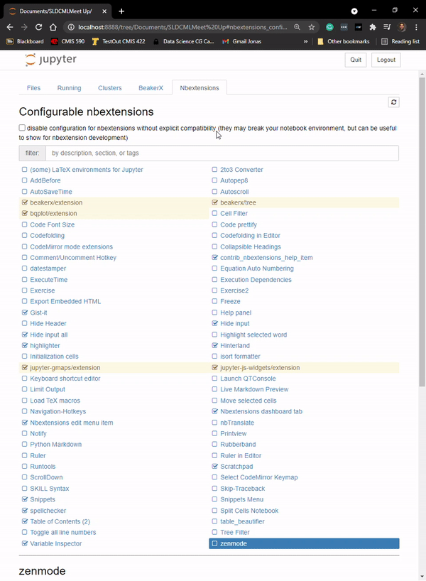
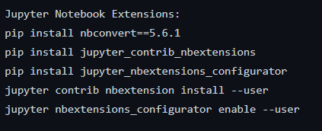
Jupyter Notebook NB Extensions
Simple Installation
Useful Extensions

Slide 18

Walkthrough with Pandas and Seaborn

Slide 19
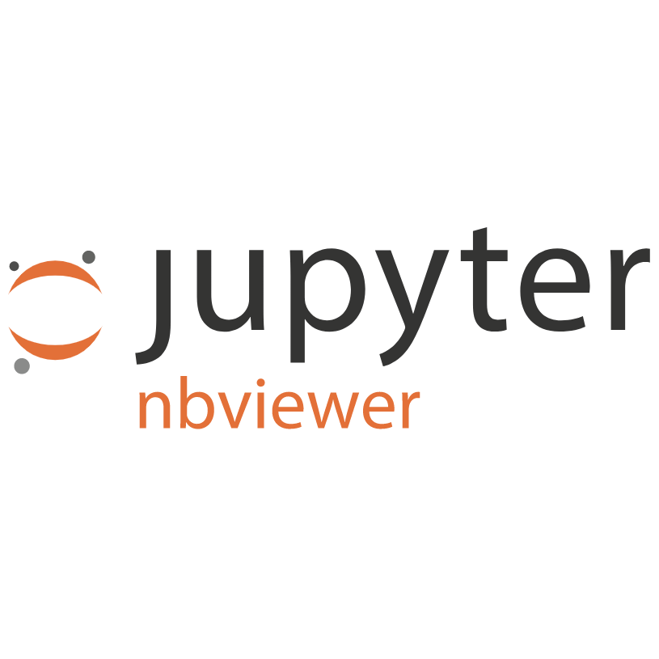


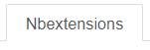
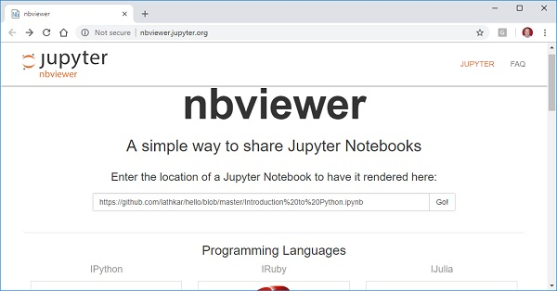
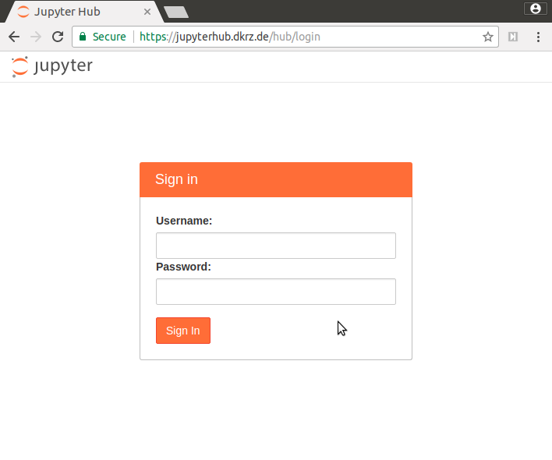
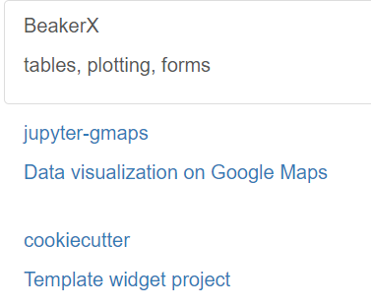
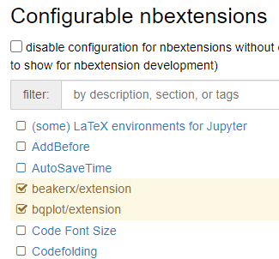
More from Jupyter Environment
NBViewer
Jupyter Hub
Widgets
NB Extensions

Slide 20
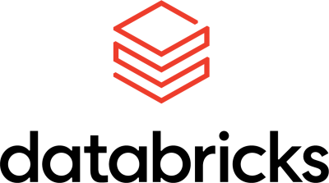


Leveraged by The Data Community

Slide 21





Conclusion
Fits Specific Use Cases
Easiness to Resolve Complex Data Limitations
Enabling Deeper Exploratory Insights
Providing for Ad Hoc Reporting Requests
More Meaningful Business Analysis

Slide 22

Thank for Your Time

Slide 23
References
Jupyter Notebook
https://jupyter-notebook-beginner-guide.readthedocs.io/en/latest/what_is_jupyter.html
https://jupyter.org/index.html
https://jupyter.org/documentation
https://www.anaconda.com/about-us
https://jupyter.org/install
Connecting Sources
https://pypi.org/project/pyodbc/
https://github.com/mkleehammer/pyodbc/wiki
Pandas
https://pandas.pydata.org/
https://pandas.pydata.org/docs/
Seaborn
https://seaborn.pydata.org/index.html
https://seaborn.pydata.org/examples/index.html#
Other Popular Delivery Methods
https://blog.jupyter.org/and-voil%C3%A0-f6a2c08a4a93
https://panel.holoviz.org/
https://medium.com/plotly/introducing-jupyterdash-811f1f57c02e
https://discuss.streamlit.io/
How to install The Basic Environment
https://www.youtube.com/watch?v=kbTSj5xTgNc
https://www.anaconda.com/products/individual
https://www.youtube.com/watch?v=vG4AHYXsOgc
Extensions
https://www.kdnuggets.com/2019/06/jupyter-notebooks-data-science-reporting.html
Notes:
Make this available for others. This could be helpful for the other folks that are unexperienced.

